Slide 1
Magnetic Work Environment
Anil Sakala

Slide 2
Agenda
Deep dive into engagement factors ( Psychological and Scientific reasons)
How can we assess engagement levels and identify action items based on assessments

Slide 3
What was discussed
What was discussed in my last presentation
Who is engaged employee ?
Where do we get them ?
RESPECT model
Q12 Questions
Today my presentation starts with explaining importance of those 12 questions and do a deep dive into employee engagement before I talk about action items

Slide 4
Gallup work place audit
What is Gallup ?
They are into business of understanding work place environment and its effect on business.
They help organizations in managing and improving work place
Why is work place important ?
We spend most of our waking hours in office
It has direct impact on our business
Gallup work place audit
Gallup up has done research for more than 50 years on employee engagement and came out with 12 questions to measure employee engagement . These Q12 are called Gallup work place audit questions
More details - http://strengths.gallup.com/private/resources/q12meta-analysis_flyer_gen_08%2008_bp.pdf

Slide 5
Gallup work place audit
What are those Q12 questions ?
They are already known to you . They revolve around RESPECT model that I have discussed
In this presentation I will talk about Ron Friedman research on modern work place. (http://thebestplacetoworkbook.com/)

Slide 6
What video games teach us about work environment
Research : Why few games are successful and few games are not successful ?
Games that fulfill psychological needs of human being are successful
When targets are clear with consistent feedback , immediate recognition and progressive difficulty , we can’t help but become absorbed
Temple run
Chess Game
Chess Game offline
We should build a similar work environment to engage employees
Who is engaged employee ?
Where do we get them ?
RESPECT model
Q12 Questions
Today my presentation starts with explaining importance of those 12 questions and do a deep dive into employee engagement before I talk about action items

Slide 7
Gallup work place audit
What was discussed in my last presentation
Who is engaged employee ?
Where do we get them ?
RESPECT model
Q12 Questions
Today my presentation starts with explaining importance of those 12 questions and do a deep dive into employee engagement before I talk about action items

Slide 8
Gallup work place audit
What was discussed in my last presentation
Who is engaged employee ?
Where do we get them ?
RESPECT model
Q12 Questions
Today my presentation starts with explaining importance of those 12 questions and do a deep dive into employee engagement before I talk about action items

Slide 9
What was discussed
What was discussed in my last presentation
Who is engaged employee ?
Where do we get them ?
RESPECT model
Q12 Questions
Today my presentation starts with explaining importance of those 12 questions and do a deep dive into employee engagement before I talk about action items

Slide 10
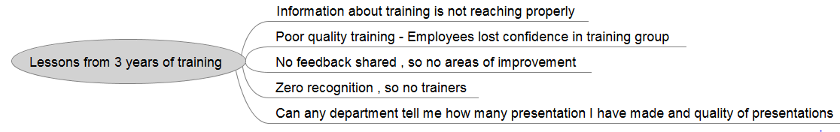
Current State

Slide 11
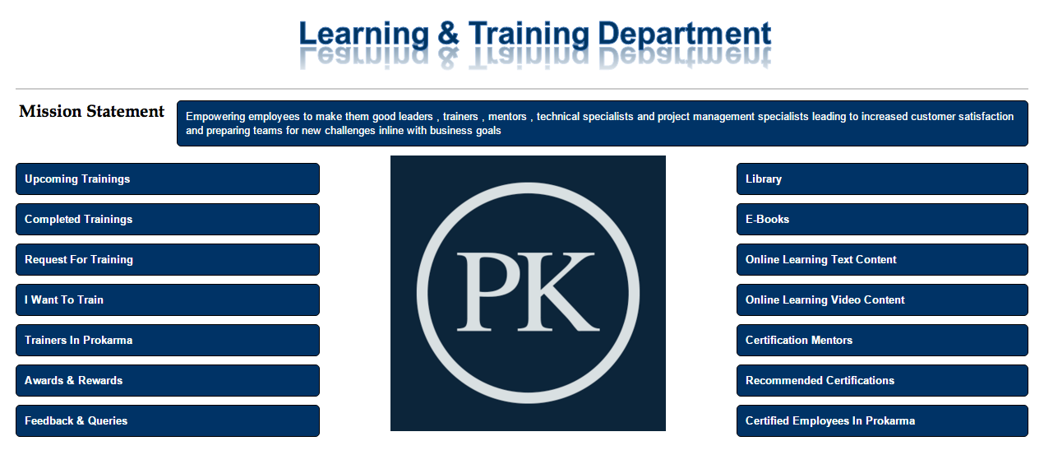
How can we fix above problems (https://wiki.prokarma.com/display/UPD/Temp)

Slide 12
Mission
I believe we require four categories of employees that will make us more successful - Great leaders , Great trainers , Great mentors , Technical & Project management experts
Our mission statement should help our people in understanding what we are doing
I have few thoughts on creating a mission statement and this is what came to my mind – “ Empowering employees to make them good Leaders , Trainers , Mentors , Technical & Project management experts leading to increased customer satisfaction and preparing teams for new challenges in line with business goals ”
Better thoughts ?

Slide 13
Upcoming Trainings
Managers are not sharing information and employees should know about trainings that are coming up and this page will be helpful for them .
Opening note talking about importance of registering to attend training (Today many are not registering)
Should contain table data with all following columns –
S.No
Presentation Topic
Presenter name
Target Audience
Timing Details
Registration link (Pointing to PKonnect )
Is manager approval required
Number of registrations (Should get updated periodically)
Status (Registration opened / Registration closed)

Slide 14
What after registration ?
Schedule a training and send out a meeting request so that it is there in their calendar and they don’t miss it out .
Attendance need to be taken for all employees who attended it .
Conduct a online survey for all the employees who attended training asking three simple questions
Good points in presentation
Areas of improvement
Overall rating
It is mandatory for an employee to attend session completely and fill survey form to get it registered with learning department
Next step is to go to completed trainings and fill it out

Slide 15
Completed Trainings
All completed trainings need to tracked here
This can be in the form of table with columns as
S.No
Presentation topic
Presenter
Completion date
Link to download PPT
Link to run video if available
No of attendees
Average rating received
Link that points to all the feedback received without names (Should be accessed only by presenter )
People come on weekends and do we really recognize them.
If there is good feedback on the training then Learning department should drop a mail to their manager and AVP appreciating the efforts of employee . This will make him repeat the act. Recognizing employees is one best way to make him repeat another good presentation
If feedback is not proper share with employee and leave it . Don’t share with manager.

Slide 16
Request for training
This page is like a product backlog list.
There should be a link to raise a request for training . All the raised requests need to be traced and Topics requested which are not fulfilled need to be displayed on this page . This can be in the form of table with columns as
S.No
Topic Requested
Pending Since
Requestor name
Vote button
Topic that are fulfilled need to be removed from this page

Slide 17
I want to train
Detailed list of guidelines for trainer
Minimum time for session
Expected quality of session
He must aware of the feedback process and average rating values
Mail details of the person to be contacted to make a session

Slide 18
Trainers in Prokarma
Main purpose of this page is to motivate employees and make them feel proud about the training work that is made
We need to display photos of all trainers who got average decent rating (3.5 and above ) and contribution made by them to training department. This approach will increase their visibility and make them feel proud.
Talk to trainers is another way of appreciating employees

Slide 19
Awards & Rewards
We have to come out with clear guidelines to give award for employees who have made outstanding contribution to learning department.
All norms and conditions for getting award need to be displayed on this page and also list to employees who received award need to be displayed.

Slide 20
E-book / Online text / Videos
Main source of learning today is e-book. For any topic there are just two or three good books and tracking those books on a single page will be useful information . I have seen few employees asking me for a good book on a specific technology .
I have any idea about format that need to be followed . I will share n meeting
On similar lines we have to go for online text and videos
Employee participation is required here . I will talk in last slide

Slide 21
Certification Mentors
We want our employees to do certification and they look for some with whom they can talk and understand process for getting certified.
This page should help such employees
Identify employees who have done certifications and if they are willing to mentor or guide people we can add them to this page

Slide 22
Recommended Certifications
All certifications as recommended by prokarma for both technical and technical areas should be displayed here .
Clear direction about certifications is present here
Few certification that are inline with organization goals need to be documented here

Slide 23
Certified employees in prokarma
Contains all employee who have done certification in technical / project management related areas .
Make employees feel proud about their certifications
Best way to sell our technical competencies to new customers.

Slide 24
Selling to employees
Once we are up and ready with our learning department
We should make a excellent presentation about
What learning department is trying to do
Explain , inspire and motivate employees to participate and contribute towards learning department
Collect feedback and make necessary changes Make employees feel proud about their certifications

